Slide 1

ModelIt!
Student Lesson
When the Earth Cracks Open
The Powerful Forces That Shape Our Planet's Surface
NGSS: MS-ESS2-2
6th Grade
1/9

Slide 2
What You Will Learn Today
Learning Goals
* Explain how convection currents in the mantle drive plate movement
* Model how plate speed, mantle heat, rock density, and friction interact at plate boundaries
* Predict what happens when tectonic plates collide, separate, or slide past each other
* Connect plate tectonics to real-world earthquake and volcano patterns
Key Vocabulary
Tectonic Plate
A massive slab of Earth's lithosphere that floats on the semi-liquid mantle below
Convection Current
A circular flow of material caused by heating from below and cooling from above
Plate Boundary
The zone where two tectonic plates meet, interact, and create geological activity
Seismic Wave
A wave of energy that travels through Earth during an earthquake
2/9

Slide 3

The Big Question
Why do earthquakes and volcanoes happen in the same places over and over again?
The Powerful Forces That Shape Our Planet's Surface. Today we'll build a MODEL to discover the answer!
3/9

Slide 4

Today We Will Build a Model!
A model helps us understand complex systems!
1. LOCATE
Identify the COMPONENTS (parts) of the system
2. ESTABLISH
Connect them with RELATIONSHIPS (+ or -)
3. VISUALIZE
Build your model in ModelIt!
4. EVALUATE
Run SIMULATIONS to test scenarios
5. REVISE
Improve your model based on evidence
4/9

Slide 5
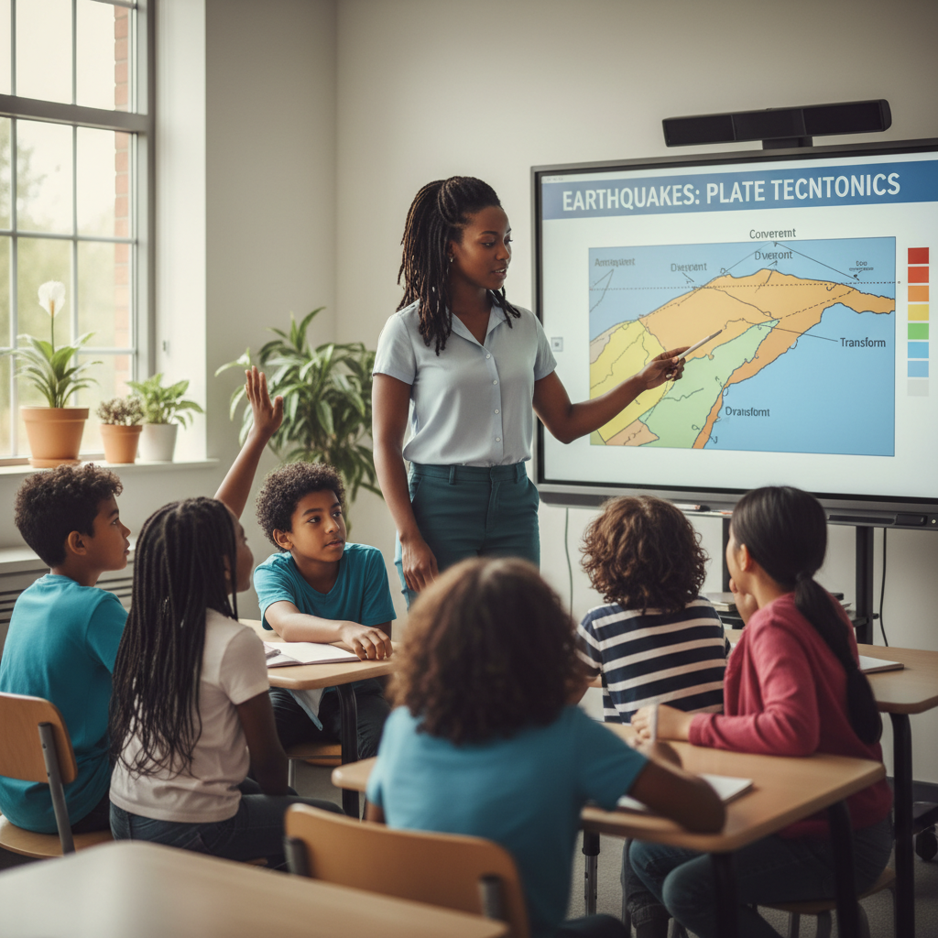
Activity 1: Sort the Components
Sort these components into EXTERNAL (inputs from outside) and INTERNAL (inside the system):
Your Components:
* Plate Movement Speed
* Mantle Heat
* Rock Density
* Boundary Friction
Think: Which components can we control? Which happen on their own?
5/9

Slide 6
Activity 2: Connect with Arrows
Draw arrows to show HOW components affect each other:
(+) POSITIVE Relationship
When one goes UP, the other goes UP too
(-) NEGATIVE Relationship
When one goes UP, the other goes DOWN
Think About It:
When mantle heat increases, what happens to plate movement speed? Does more friction at a boundary make earthquakes more or less powerful?
6/9

Slide 7
Activity 3: Run the Simulation!
Test these scenarios in ModelIt!
Slow Drift
Set Mantle Heat and Plate Movement Speed to low levels and observe geological activity
Heat Surge
Lock Mantle Heat to maximum and observe how plates respond over time
Friction Lockup
Set Boundary Friction to maximum and watch what builds up before release
Watch the activity graphs change!
[ModelIt Platform Screenshot - Simulation Results Graph]
7/9

Slide 8
What Did We Discover?
Our Model Showed Us:
* Earthquakes and volcanoes cluster along plate boundaries — they're not random at all
* Higher mantle heat drives faster convection currents, pushing plates faster
* More boundary friction means energy builds up longer — resulting in BIGGER earthquakes when it finally releases
* The densest plates get pushed under lighter plates (subduction), creating deep ocean trenches and volcanoes
Answer: Earthquakes and volcanoes happen in the same places because that's where tectonic plates meet. The boundaries between plates are zones of enormous stress, and the heat from Earth's interior keeps pushing plates together, apart, or sideways — creating predictable patterns of geological activity.
8/9

Slide 9

STEM Challenge: Design an Earthquake-Ready City
YOUR ENGINEERING MISSION
Design a city near a plate boundary that can withstand earthquakes using evidence from your tectonic model about earthquake intensity and frequency.
The Challenge:
A new city is being planned near the San Andreas Fault in California. The city council needs your engineering team to recommend building designs, infrastructure, and emergency systems based on what your model reveals about earthquake patterns.
Think Like an Engineer:
* Based on your model, how strong could earthquakes get at this boundary?
* What building designs would best survive the type of shaking your model predicts?
* How should emergency response systems be designed based on earthquake frequency patterns?
REAL CAREER CONNECTION: Seismologists and Geophysicists study earthquakes and Earth's interior to predict hazards and design safer communities. They earn $70,000–$130,000/year. The skills you're using TODAY are the same ones they use on the job!
9/9

